Slide 1
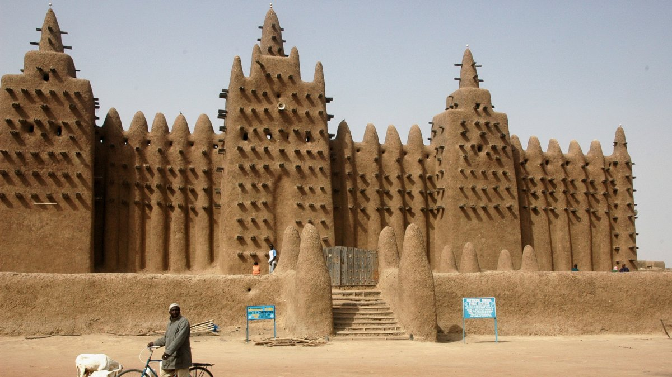
West Africa Vocabulary

Slide 2
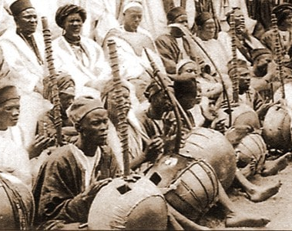
Griots
West African storytellers

Slide 3
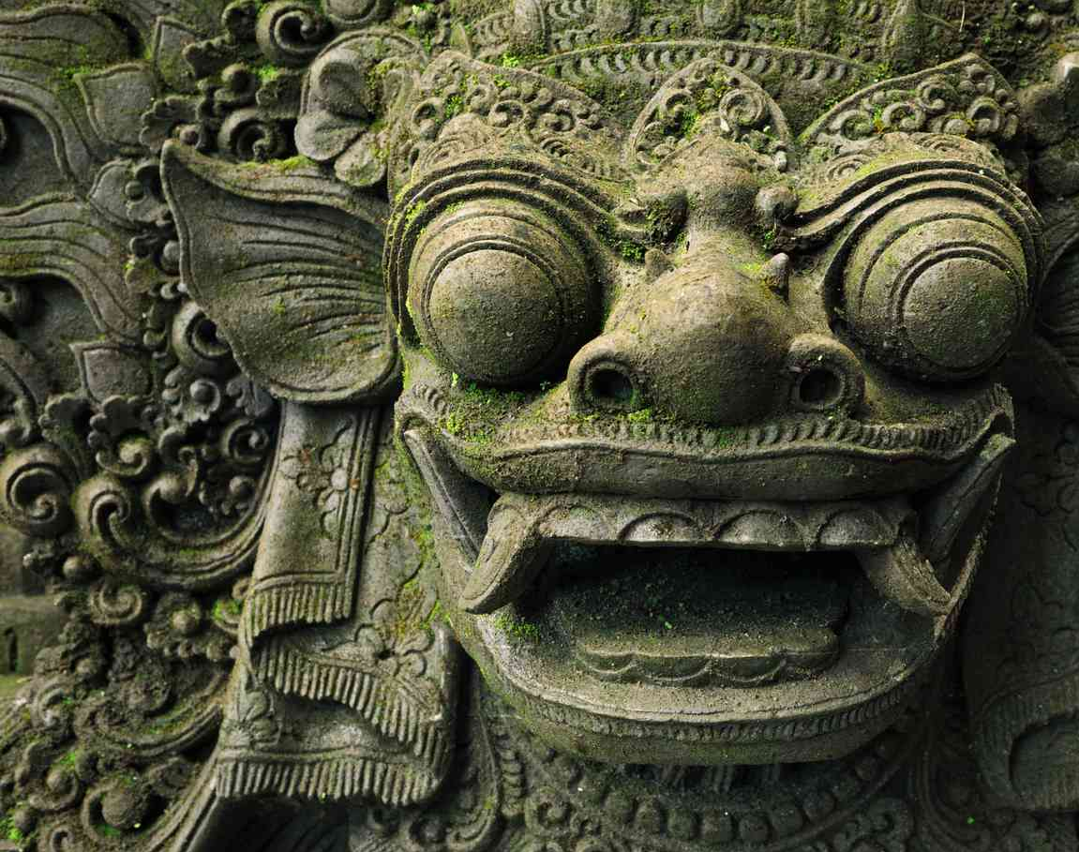
Animism
The belief that spirits or souls are found in all natural objects.

Slide 4
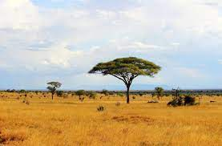
Savanna
Tropical grasslands dotted with small trees and shrubs.

Slide 5
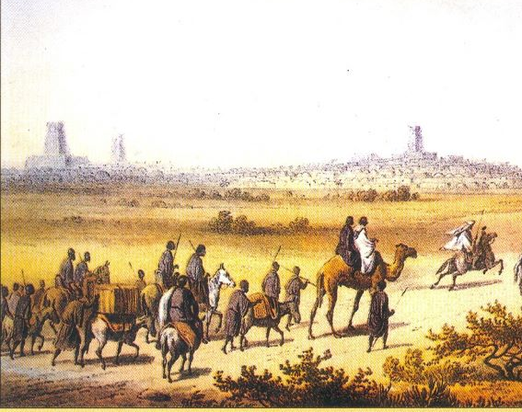
Trans-Saharan Trade Route
A trade route crossing the Sahara that linked trade between Africa and the rest of the world.

Slide 6
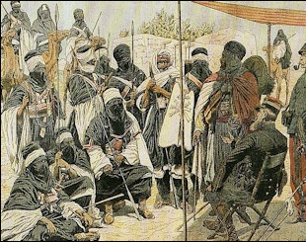
Berbers
Traders from North Africa

Slide 7
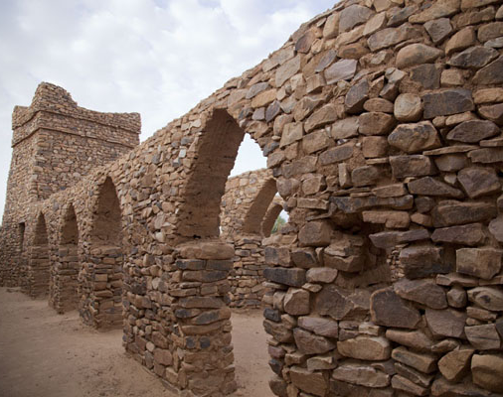
Ghana
The first great trading empire in West Africa

Slide 8
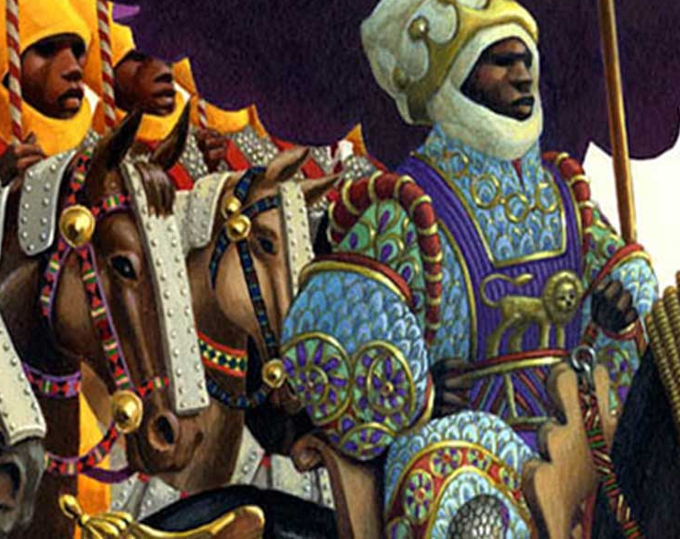
Mali
An empire that built its wealth and power on the gold and salt trade networks.

Slide 9
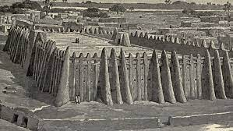
Songhai
The largest and last of the three major empires in West Africa.

Slide 10
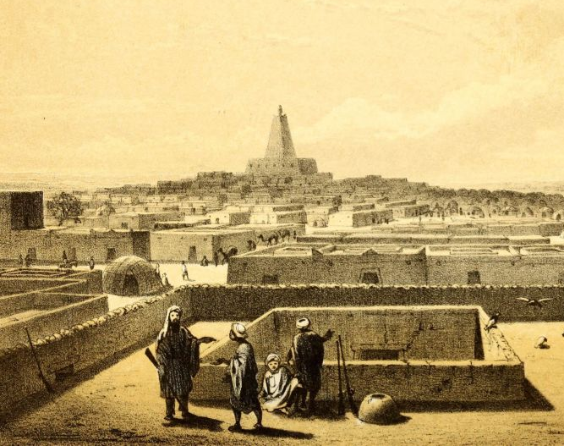
Mansa Musa
The greatest Mali king, he turned the empire into a major trading city and center of learning.

Slide 11
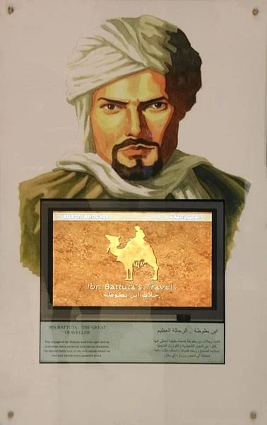
Ibn Battuta
A young Arab lawyer who wrote about his travels in West Africa.

Slide 12
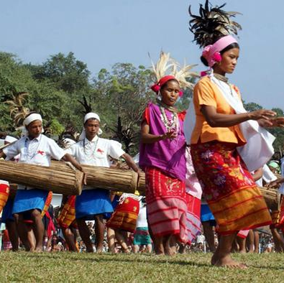
Matrilineal
Tracing descent through mothers

Slide 13
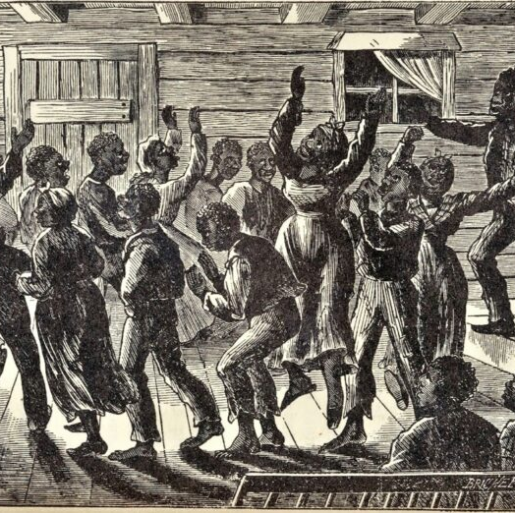
Spirituals
Songs of religious faith and hope for freedom

Slide 14
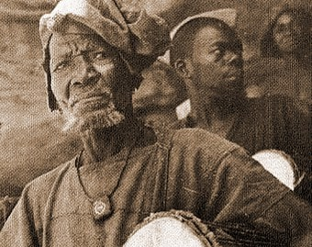
Oral History
History told by people instead of being written.

